Slide 1
Portfolio Web Developer
Firman Najib

Slide 2
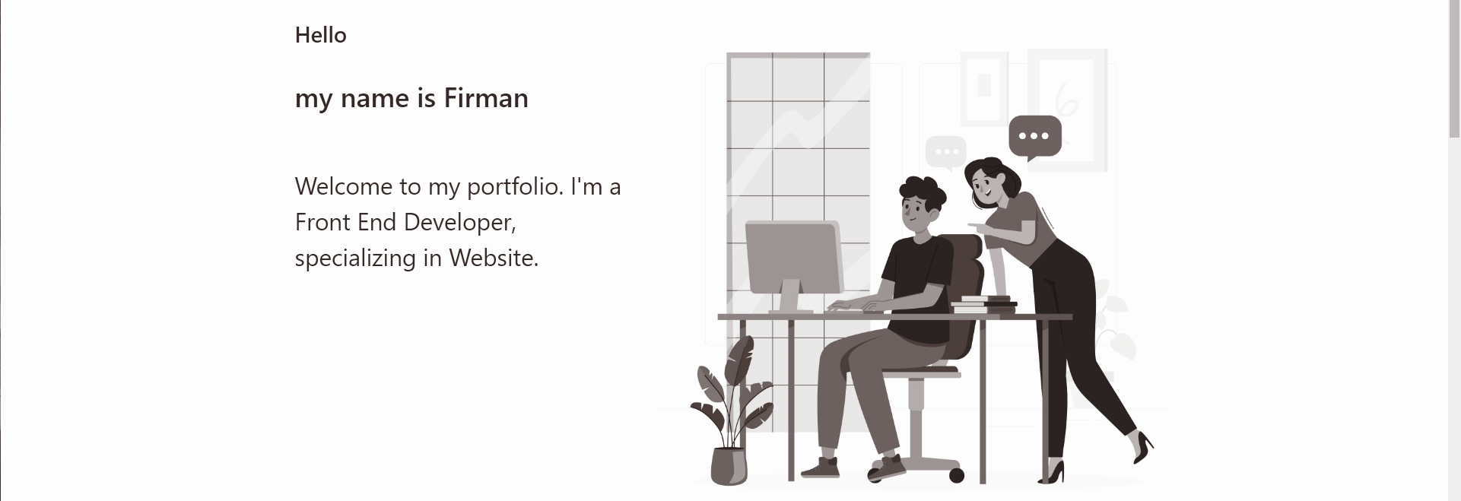
Introduction

Slide 3


Slide 4

Stacks

Slide 5
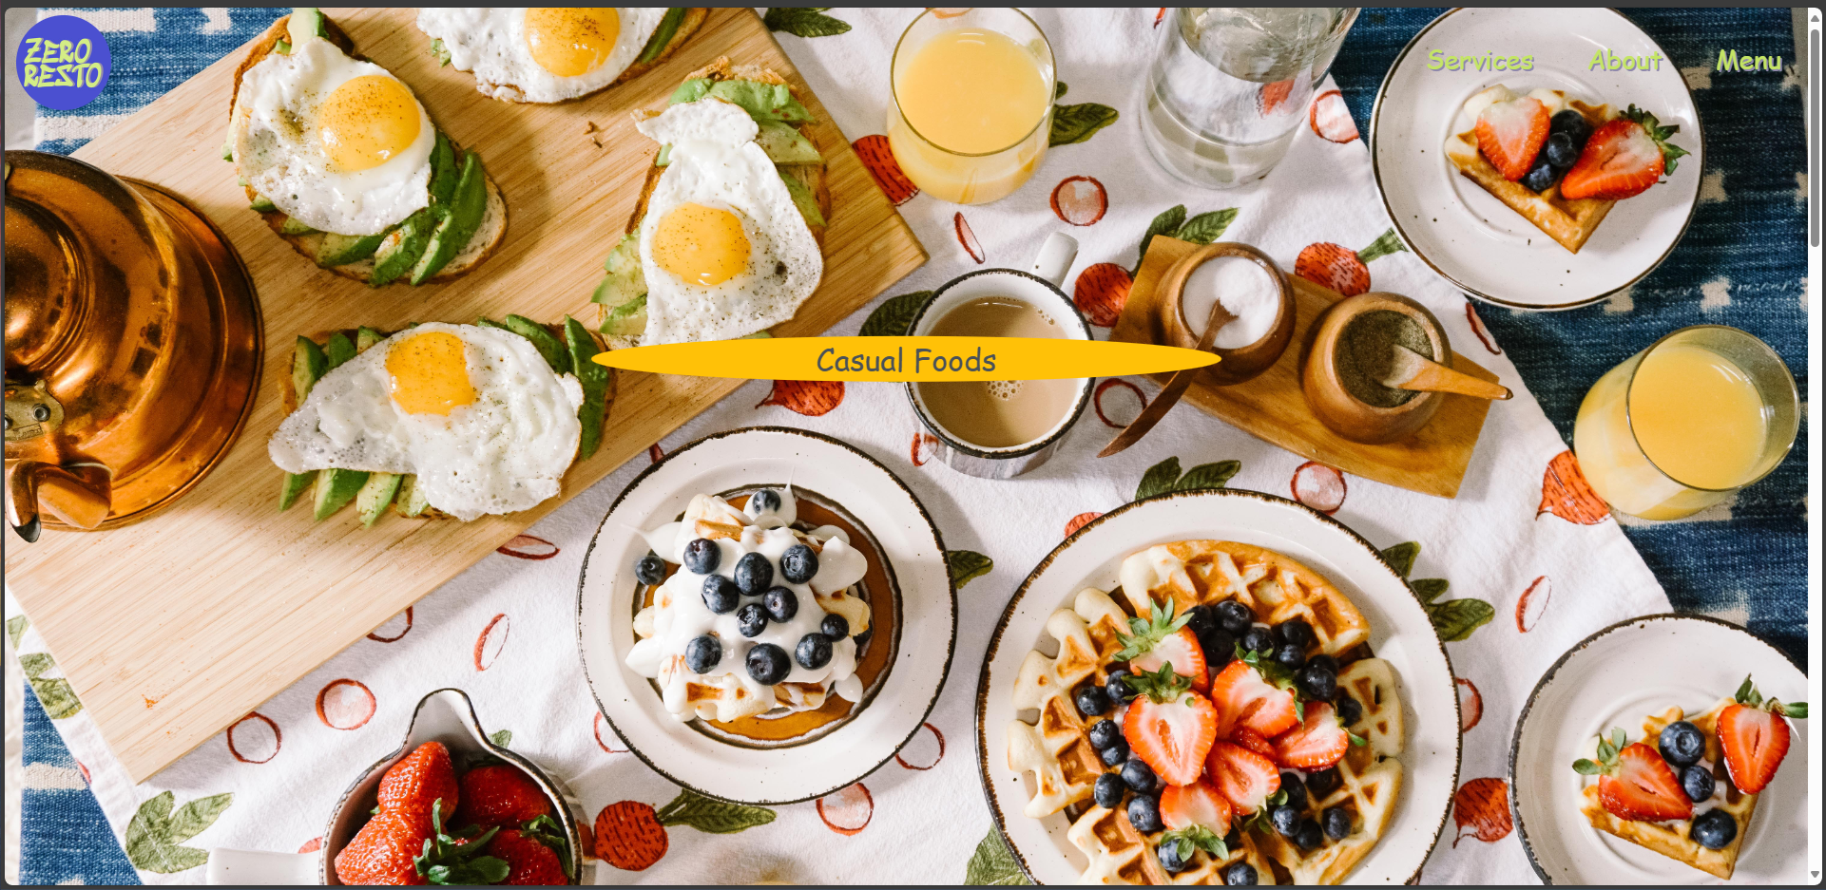
Project 1
Zero Resto
Restaurant Website which provide variant western casual menus with price tag and name.

Slide 6
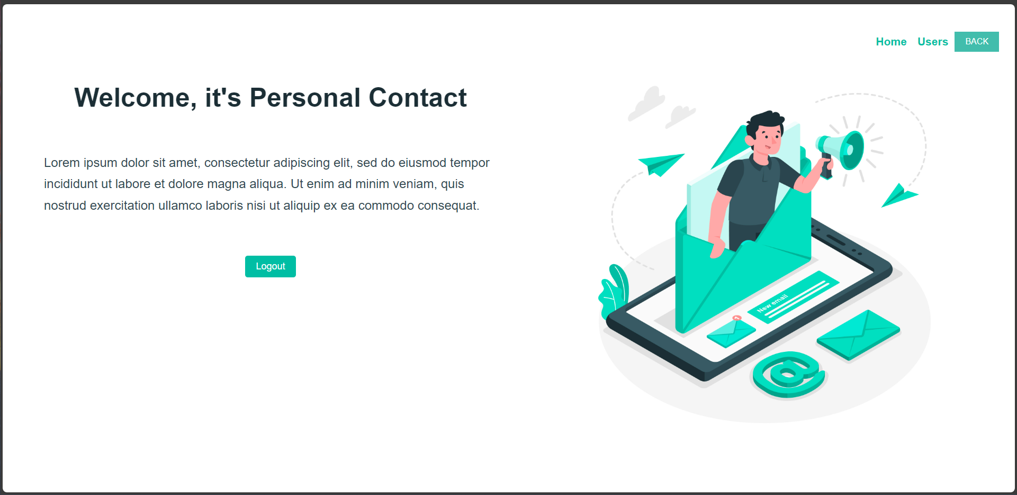
Project 2
Personal Contact
This is a website with contact list which allow you to add and delete contact.

Slide 7
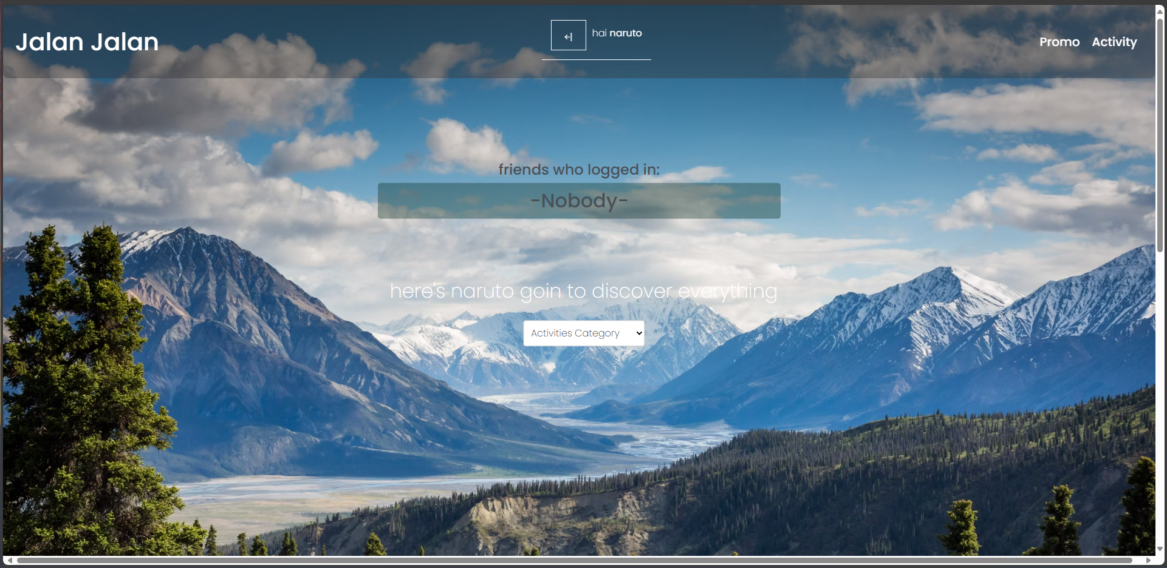
Project 3
Jalan Jalan
Jalan Jalan is a website for people who are looking for travel. It Developed in two perspective. First, it is a travel agency. Second, it is a travel blog.

Slide 8

Get in touch
Github:
https://github.com/FirmanNaufalNajib
Website:
portofirmandibimbing.vercel.app

